Slide 1
Australian attitudes
In song and poem
Dr Alexanne Don
Hong Kong University
April, 2014

Slide 2
why look at poem and song
how they make their meanings
and
how they function as identity repositories
-- some explorations and comparisons using Appraisal and the transitivity system

Slide 3
Identity:
We can look at ‘scriptures’ (or Oracles: heritage artefacts Tann 2010) which organise and appeal to our responses via cycles of recontexualising resources:
via
associations with iconic imagery
images → iconic of an ‘identity’ national/ethnic/tribal..
this identity becomes saturated with concepts which are in turn associated with a target → re-iconicised
some poems appeal to emotions/values, others use story, others appropriate voices to use stance
entities (Targets) valorised, either negatively or positively..

Slide 4
Identity:
My overall questions for looking at national identity through ‘Oracles’ are:
How do Australians see themselves? what do they reject?
Who addresses whom, and with what relationships? (Immigrants/ Europeans/ colonists/ English-speaking)
What associations or bonds are set up?: with landforms (hills, plains), parts of the land (gum trees, kangaroos), traditional artefacts (songs, clothing)
How does this develop and change over time?

Slide 5
using representative texts (Oracles) on a topic -
What Attitudes towards what Targets using
what associations
how Participants and Processes are related
…and how these interrelate in staging the text

Slide 6
..so today we’ll look at
Attitudes:
sources, or Appraisers, of Attitude
types of Attitude,
positive or negative,
inscribed or invoked,
Targets of these Attitudes,
clustering of Attitude types around what Targets
Transitivity:
Process types
active Participants

Slide 7
..most Australians recognise this line
I love a sunburnt country
they know what comes next..

Slide 8
It’s actually the 2nd stanza..
I love a sunburnt country
A land of sweeping plains,
Of ragged mountain ranges,
Of drought and flooding rains,
I love her far horizons,
I love her jewel sea,
Her beauty and her terror –
The wide brown land for me.
We all learnt this stanza in primary school:
it is now an ‘icon’, a scripture, representing an aspect of our identities

Slide 9
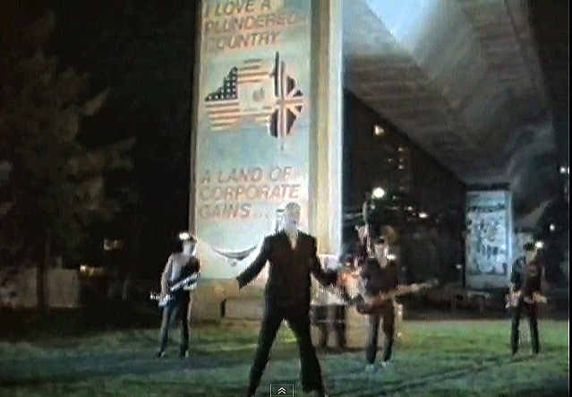
If it were not an icon, someone could not have re-semioticised the lines in this way..
Midnight Oil: “Power and the Passion” 1982

Slide 10
If it were not an icon, someone could not have re-semioticised the lines in this way..
I love a plundered country,
A land of corporate gains...

Slide 11
who wrote the original and when?
I love a sunburnt country
A land of sweeping plains,
Of ragged mountain ranges,
Of drought and flooding rains,
I love her far horizons,
I love her jewel sea,
Her beauty and her terror –
The wide brown land for me.
Dorothea McKellar, 1st published 1908

Slide 12
The 1st stanza repudiates the ‘English’ gaze
1. The love of field and coppice,
Of green and shaded Lanes,
Of ordered woods and gardens,
Is running in your veins;
Strong love of grey-blue distance,
Brown streams and soft, dim skies –
I know but cannot share it,
My love is otherwise.
2. I love a sunburnt country
A land of sweeping plains,
Of ragged mountain ranges,
Of drought and flooding rains,
I love her far horizons,
I love her jewel sea,
Her beauty and her terror –
The wide brown land for me.

Slide 13
Here’s the rest
3. The tragic ring-barked forests
Stark white beneath the moon,
The sapphire-misted mountains,
The hot gold hush of noon.
Green tangle of the brushes
Where lithe lianas coil,
And orchids deck the tree-tops
And ferns the crimson soil.
4. Core of my heart, my country!
Her pitiless blue sky,
When sick at heart around us
We see the cattle die -
But then the grey clouds gather
And we can bless again
The drumming of an army,
The steady, soaking rain.
5. Core of my heart, my country!
Land of the Rainbow Gold,
For flood and fire and famine,
She pays us back threefold;
Over the thirsty paddocks,
Watch, after many days,
The filmy veil of greenness
That thickens as we gaze.
6. An opal-hearted country,
A wilful, lavish land -
All you who have not loved her,
You will not understand -
Though Earth holds many splendours,
Wherever I may die,
I know to what brown Country
My homing thoughts will fly.

Slide 14
Who appraises and what is appraised?
There are two sources of Attitude,
two direct Targets and
one indirect Target…

Slide 15
Who appraises and what is appraised?
Two sources of Attitude:
- I : writer (McKellar)
as representative of we/white Australians
- You : plural?
attitude attributed to:
‘you’ → Europeans

Slide 16
Who appraises and what is appraised?
So ‘we’ Australians know, and can evaluate,
and ‘you’ Europeans do not understand, but we know how you evaluate..

Slide 17
Who appraises and what is appraised?
Two direct targets of Attitude:
  - grey-blue distance, etc [European landforms]
  - a sunburnt country, etc [Australian landforms]

Slide 18
Who appraises and what is appraised?
One indirect Target:
  - the ‘you who cannot share it’
  = I must explain to you
  - the whole poem is addressed to those Europeans, explaining their ignorance to them, explaining why they look down on the land and its inhabitants – how they are wrong

Slide 19
So, how is the sunburnt country represented…
Through Attitude?
Through use of Processes and Participants?

Slide 20
How is the sunburnt country represented…
First, let’s look at Attitude –
  - in the McKellar piece, this is effected via:
contrast with repudiated Targets
valorisation using high value Affect and
reference to extreme conditions

Slide 21
How is the sunburnt country represented…
Through Attitude (Affect highlighted)
via contrast with repudiated Targets:
    landforms and their actions
    (check bold and italic)
    we, us, our versus you, your
    (check coloured blues)

Slide 22
1. The love of field and coppice,
Of green and shaded Lanes,
Of ordered woods and gardens,
Is running in your veins;
Strong love of grey-blue distance,
Brown streams and soft, dim skies -
I know but cannot share it,
My love is otherwise.
2. I love a sunburnt country,
A land of sweeping plains,
Of ragged mountain ranges,
Of drought and flooding rains,
I love her far horizons,
I love her jewel sea,
Her beauty and her terror -
The wide brown land for me.
3. The tragic ring-barked forests
Stark white beneath the moon,
The sapphire-misted mountains,
The hot gold hush of noon.
Green tangle of the brushes
Where lithe lianas coil,
And orchids deck the tree-tops
And ferns the crimson soil.
4. Core of my heart, my country!
Her pitiless blue sky,
When sick at heart around us
We see the cattle die -
But then the grey clouds gather
And we can bless again
The drumming of an army,
The steady, soaking rain.
5. Core of my heart, my country!
Land of the Rainbow Gold,
For flood and fire and famine,
She pays us back threefold;
Over the thirsty paddocks,
Watch, after many days,
The filmy veil of greenness
That thickens as we gaze.
6. An opal-hearted country,
A wilful, lavish land -
All you who have not loved her,
You will not understand -
Though Earth holds many splendours,
Wherever I may die,
I know to what brown Country
My homing thoughts will fly.
1st stanza
last stanza

Slide 23
Let’s look again at some aspects of how the sunburnt country represented…
Through Attitude (Affect highlighted)
via contrast with repudiated Targets:
    landforms and their actions
    we, us, our versus you, your
e.g. soft dim skies versus pitiless blue sky

Slide 24
1. The love of field and coppice,
Of green and shaded Lanes,
Of ordered woods and gardens,
Is running in your veins;
Strong love of grey-blue distance,
Brown streams and soft, dim skies -
I know but cannot share it,
My love is otherwise.
2. I love a sunburnt country,
A land of sweeping plains,
Of ragged mountain ranges,
Of drought and flooding rains,
I love her far horizons,
I love her jewel sea,
Her beauty and her terror -
The wide brown land for me.
3. The tragic ring-barked forests
Stark white beneath the moon,
The sapphire-misted mountains,
The hot gold hush of noon.
Green tangle of the brushes
Where lithe lianas coil,
And orchids deck the tree-tops
And ferns the crimson soil.
4. Core of my heart, my country!
Her pitiless blue sky,
When sick at heart around us
We see the cattle die -
But then the grey clouds gather
And we can bless again
The drumming of an army,
The steady, soaking rain.
5. Core of my heart, my country!
Land of the Rainbow Gold,
For flood and fire and famine,
She pays us back threefold;
Over the thirsty paddocks,
Watch, after many days,
The filmy veil of greenness
That thickens as we gaze.
6. An opal-hearted country,
A wilful, lavish land -
All you who have not loved her,
You will not understand -
Though Earth holds many splendours,
Wherever I may die,
I know to what brown Country
My homing thoughts will fly.

Slide 25
How is the sunburnt country represented…
Through Attitude (Affect highlighted)
via contrast with repudiated Targets:
    landforms and their actions highlighted..

Slide 26
1. The love of field and coppice,
Of green and shaded Lanes,
Of ordered woods and gardens,
Is running in your veins;
Strong love of grey-blue distance,
Brown streams and soft, dim skies -
I know but cannot share it,
My love is otherwise.
2. I love a sunburnt country,
A land of sweeping plains,
Of ragged mountain ranges,
Of drought and flooding rains,
I love her far horizons,
I love her jewel sea,
Her beauty and her terror -
The wide brown land for me.
3. The tragic ring-barked forests
Stark white beneath the moon,
The sapphire-misted mountains,
The hot gold hush of noon.
Green tangle of the brushes
Where lithe lianas coil,
And orchids deck the tree-tops
And ferns the crimson soil.
4. Core of my heart, my country!
Her pitiless blue sky,
When sick at heart around us
We see the cattle die -
But then the grey clouds gather
And we can bless again
The drumming of an army,
The steady, soaking rain.
5. Core of my heart, my country!
Land of the Rainbow Gold,
For flood and fire and famine,
She pays us back threefold;
Over the thirsty paddocks,
Watch, after many days,
The filmy veil of greenness
That thickens as we gaze.
6. An opal-hearted country,
A wilful, lavish land -
All you who have not loved her,
You will not understand -
Though Earth holds many splendours,
Wherever I may die,
I know to what brown Country
My homing thoughts will fly.

Slide 27
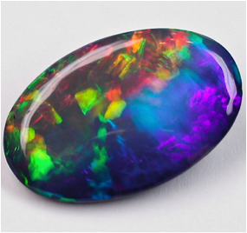
How is the sunburnt country represented…
Many-coloured contrasts, e.g.
    Opal-hearted

Slide 28
1. The love of field and coppice,
Of green and shaded Lanes,
Of ordered woods and gardens,
Is running in your veins;
Strong love of grey-blue distance,
Brown streams and soft, dim skies -
I know but cannot share it,
My love is otherwise.
2. I love a sunburnt country,
A land of sweeping plains,
Of ragged mountain ranges,
Of drought and flooding rains,
I love her far horizons,
I love her jewel sea,
Her beauty and her terror -
The wide brown land for me.
3. The tragic ring-barked forests
Stark white beneath the moon,
The sapphire-misted mountains,
The hot gold hush of noon.
Green tangle of the brushes
Where lithe lianas coil,
And orchids deck the tree-tops
And ferns the crimson soil.
4. Core of my heart, my country!
Her pitiless blue sky,
When sick at heart around us
We see the cattle die -
But then the grey clouds gather
And we can bless again
The drumming of an army,
The steady, soaking rain.
5. Core of my heart, my country!
Land of the Rainbow Gold,
For flood and fire and famine,
She pays us back threefold;
Over the thirsty paddocks,
Watch, after many days,
The filmy veil of greenness
That thickens as we gaze.
6. An opal-hearted country,
A wilful, lavish land -
All you who have not loved her,
You will not understand -
Though Earth holds many splendours,
Wherever I may die,
I know to what brown Country
My homing thoughts will fly.

Slide 29
How is the sunburnt country represented…
Through Attitude?
via valorisation using high value Affect
    inscribed and flagged (provoked)
    afforded (evoked)
    targets

Slide 30
1. The love of field and coppice,
Of green and shaded Lanes,
Of ordered woods and gardens,
Is running in your veins;
Strong love of grey-blue distance,
Brown streams and soft, dim skies -
I know but cannot share it,
My love is otherwise.
2. I love a sunburnt country,
A land of sweeping plains,
Of ragged mountain ranges,
Of drought and flooding rains,
I love her far horizons,
I love her jewel sea,
Her beauty and her terror -
The wide brown land for me.
3. The tragic ring-barked forests
Stark white beneath the moon,
The sapphire-misted mountains,
The hot gold hush of noon.
Green tangle of the brushes
Where lithe lianas coil,
And orchids deck the tree-tops
And ferns the crimson soil.
4. Core of my heart, my country!
Her pitiless blue sky,
When sick at heart around us
We see the cattle die -
But then the grey clouds gather
And we can bless again
The drumming of an army,
The steady, soaking rain.
5. Core of my heart, my country!
Land of the Rainbow Gold,
For flood and fire and famine,
She pays us back threefold;
Over the thirsty paddocks,
Watch, after many days,
The filmy veil of greenness
That thickens as we gaze.
6. An opal-hearted country,
A wilful, lavish land -
All you who have not loved her,
You will not understand -
Though Earth holds many splendours,
Wherever I may die,
I know to what brown Country
My homing thoughts will fly.

Slide 31
How is the sunburnt country represented…
Through Attitude?
via valorisation using some Appreciation
    inscribed and flagged (provoked)
    afforded (evoked)
    targets

Slide 32
1. The love of field and coppice,
Of green and shaded Lanes,
Of ordered woods and gardens,
Is running in your veins;
Strong love of grey-blue distance,
Brown streams and soft, dim skies -
I know but cannot share it,
My love is otherwise.
2. I love a sunburnt country,
A land of sweeping plains,
Of ragged mountain ranges,
Of drought and flooding rains,
I love her far horizons,
I love her jewel sea,
Her beauty and her terror -
The wide brown land for me.
3. The tragic ring-barked forests
Stark white beneath the moon,
The sapphire-misted mountains,
The hot gold hush of noon.
Green tangle of the brushes
Where lithe lianas coil,
And orchids deck the tree-tops
And ferns the crimson soil.
4. Core of my heart, my country!
Her pitiless blue sky,
When sick at heart around us
We see the cattle die -
But then the grey clouds gather
And we can bless again
The drumming of an army,
The steady, soaking rain.
5. Core of my heart, my country!
Land of the Rainbow Gold,
For flood and fire and famine,
She pays us back threefold;
Over the thirsty paddocks,
Watch, after many days,
The filmy veil of greenness
That thickens as we gaze.
6. An opal-hearted country,
A wilful, lavish land -
All you who have not loved her,
You will not understand -
Though Earth holds many splendours,
Wherever I may die,
I know to what brown Country
My homing thoughts will fly.

Slide 33
How is the sunburnt country represented…
Through Attitude?
via valorisation using some Judgement
    inscribed and flagged (provoked)
    afforded (evoked)
    targets

Slide 34
1. The love of field and coppice,
Of green and shaded Lanes,
Of ordered woods and gardens,
Is running in your veins;
Strong love of grey-blue distance,
Brown streams and soft, dim skies -
I know but cannot share it,
My love is otherwise.
2. I love a sunburnt country,
A land of sweeping plains,
Of ragged mountain ranges,
Of drought and flooding rains,
I love her far horizons,
I love her jewel sea,
Her beauty and her terror -
The wide brown land for me.
3. The tragic ring-barked forests
Stark white beneath the moon,
The sapphire-misted mountains,
The hot gold hush of noon.
Green tangle of the brushes
Where lithe lianas coil,
And orchids deck the tree-tops
And ferns the crimson soil.
4. Core of my heart, my country!
Her pitiless blue sky,
When sick at heart around us
We see the cattle die -
But then the grey clouds gather
And we can bless again
The drumming of an army,
The steady, soaking rain.
5. Core of my heart, my country!
Land of the Rainbow Gold,
For flood and fire and famine,
She pays us back threefold;
Over the thirsty paddocks,
Watch, after many days,
The filmy veil of greenness
That thickens as we gaze.
6. An opal-hearted country,
A wilful, lavish land -
All you who have not loved her,
You will not understand -
Though Earth holds many splendours,
Wherever I may die,
I know to what brown Country
My homing thoughts will fly.
ambiguous

Slide 35
How is the sunburnt country represented…
by reference to extreme conditions

Slide 36
1. The love of field and coppice,
Of green and shaded Lanes,
Of ordered woods and gardens,
Is running in your veins;
Strong love of grey-blue distance,
Brown streams and soft, dim skies -
I know but cannot share it,
My love is otherwise.
2. I love a sunburnt country,
A land of sweeping plains,
Of ragged mountain ranges,
Of drought and flooding rains,
I love her far horizons,
I love her jewel sea,
Her beauty and her terror -
The wide brown land for me.
3. The tragic ring-barked forests
Stark white beneath the moon,
The sapphire-misted mountains,
The hot gold hush of noon.
Green tangle of the brushes
Where lithe lianas coil,
And orchids deck the tree-tops
And ferns the crimson soil.
4. Core of my heart, my country!
Her pitiless blue sky,
When sick at heart around us
We see the cattle die -
But then the grey clouds gather
And we can bless again
The drumming of an army,
The steady, soaking rain.
5. Core of my heart, my country!
Land of the Rainbow Gold,
For flood and fire and famine,
She pays us back threefold;
Over the thirsty paddocks,
Watch, after many days,
The filmy veil of greenness
That thickens as we gaze.
6. An opal-hearted country,
A wilful, lavish land -
All you who have not loved her,
You will not understand -
Though Earth holds many splendours,
Wherever I may die,
I know to what brown Country
My homing thoughts will fly.

Slide 37
McKellar’s piece associates Australia and its land and conditions with those who withstand and love it -
- despite (because of) these extremes, contrasts, changeability
Australia: Land of extremes:
drought and flood, beauty and terror, greenness and crimson, sweeping plains and ragged mountains, fire, famine, pitiless blue, lavish and wilful
Australian colonists: ‘we’ lovers of extremes
Europeans: ignorant of [strange beauty]

Slide 38
How is the sunburnt country represented…
How about Processes and Participants?
Material Processes
Mental Processes
Relational Processes
Participant/Subjects

Slide 39
1. The love of field and coppice,
Of green and shaded Lanes,
Of ordered woods and gardens,
Is running in your veins;
Strong love of grey-blue distance,
Brown streams and soft, dim skies -
I know but cannot share it,
My love is otherwise.
2. I love a sunburnt country,
A land of sweeping plains,
Of ragged mountain ranges,
Of drought and flooding rains,
I love her far horizons,
I love her jewel sea,
Her beauty and her terror -
The wide brown land for me.
3. The tragic ring-barked forests
Stark white beneath the moon,
The sapphire-misted mountains,
The hot gold hush of noon.
Green tangle of the brushes
Where lithe lianas coil,
And orchids deck the tree-tops
And ferns [^] the crimson soil.
4. Core of my heart, my country!
Her pitiless blue sky,
When sick at heart around us
We see the cattle die -
But then the grey clouds gather
And we can bless again
The drumming of an army,
The steady, soaking rain.
5. Core of my heart, my country!
Land of the Rainbow Gold,
For flood and fire and famine,
She pays us back threefold;
Over the thirsty paddocks,
Watch, after many days,
The filmy veil of greenness
That thickens as we gaze.
6. An opal-hearted country,
A wilful, lavish land -
All you who have not loved her,
You will not understand -
Though Earth holds many splendours,
Wherever I may die,
I know to what brown Country
My homing thoughts will fly.

Slide 40
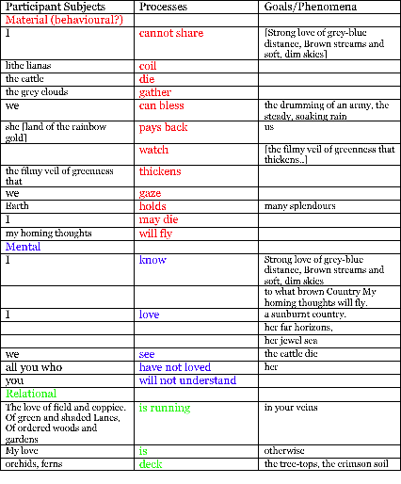

Slide 41
So –
Green and shaded lanes, ordered woods and gardens…
versus
Far horizons, sweeping plains, ragged mountain ranges….

Slide 42
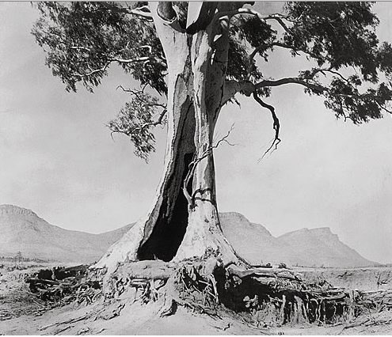
Australian icon:
the old tree
sweeping plains
ragged mountain ranges
“The Spirit of Endurance”
aka “Cazneaux’s tree”, near Wilpena Pound, SA.

Slide 43
The Spirit of Australia..
In May 1941, Cazneaux wrote:
“This giant gum tree stands in solitary grandeur on a lonely plateau in the arid Flinders Ranges, South Australia, where it has grown up from a sapling through the years and long before the shade from its giant limbs ever gave shelter from the heat to white man. The passing of the years has left it scarred and marked by the elements – storm, fire, water, unconquered it speaks to us of a Spirit of Endurance. Although aged, its widespread limbs speak of a vitality that will carry on for many more years. One day when the sun shone hot and strong, I stood before this giant in silent wonder and admiration. The hot wind stirred the leafy boughs and some of the living elements of this tree passed to me in understanding and friendliness expressing the “Spirit of Australia.”

Slide 44
Between McKellar’s Federation piece and the publication of the following poem, insert two world wars in which Australians fought in Europe and elsewhere with still a British Head of State...
'AUSTRALIA'
[From A. D. Hope, COLLECTED POEMS 1930-1970,
Angus and Robertson, Sydney 1972]

Slide 45
Nation of trees, drab green and desolate grey
In the field uniform of modern wars,
Darkens her hills, those endless, outstretched paws
Of Sphinx demolished or stone lion worn away.
They call her a young country, but they lie:
She is the last of lands, the emptiest,
A woman beyond her change of life, a breast
Still tender but within the womb is dry.
Without songs, architecture, history:
The emotions and superstitions of younger lands,
Her rivers of water drown among inland sands,
The river of her immense stupidity
Floods her monotonous tribes from Cairns to Perth.
In them at last the ultimate men arrive
Whose boast is not: "we live" but "we survive",
A type who will inhabit the dying earth.
And her five cities, like five teeming sores,
Each drains her: a vast parasite robber-state
Where second hand Europeans pullulate
Timidly on the edge of alien shores.
Yet there are some like me turn gladly home
From the lush jungle of modern thought, to find
The Arabian desert of the human mind,
Hoping, if still from the deserts the prophets come,
Such savage and scarlet as no green hills dare
Springs in that waste, some spirit which escapes
The learned doubt, the chatter of cultured apes
Which is called civilization over there.

Slide 46
Let’s look at Attitude first –
Affect, then Appreciation and Judgement
and what Targets are evaluated…
… how does the use of Attitude, and the Sources and Targets of Attitude differ from the McKellar piece?

Slide 47
Targets of Attitude are similar to McKellar’s:
Landforms,
colonists,
Europeans ‘over there’

Slide 48
Nation of trees, drab green and desolate grey
In the field uniform of modern wars,
Darkens her hills, those endless, outstretched paws
Of Sphinx demolished or stone lion worn away.
They call her a young country, but they lie:
She is the last of lands, the emptiest,
A woman beyond her change of life, a breast
Still tender but within the womb is dry.
Without songs, architecture, history:
The emotions and superstitions of younger lands,
Her rivers of water drown among inland sands,
The river of her immense stupidity
Floods her monotonous tribes from Cairns to Perth.
In them at last the ultimate men arrive
Whose boast is not: "we live" but "we survive",
A type who will inhabit the dying earth.
And her five cities, like five teeming sores,
Each drains her: a vast parasite robber-state
Where second hand Europeans pullulate
Timidly on the edge of alien shores.
Yet there are some like me turn gladly home
From the lush jungle of modern thought, to find
The Arabian desert of the human mind,
Hoping, if still from the deserts the prophets come,
Such savage and scarlet as no green hills dare
Springs in that waste, some spirit which escapes
The learned doubt, the chatter of cultured apes
Which is called civilization over there.

Slide 49
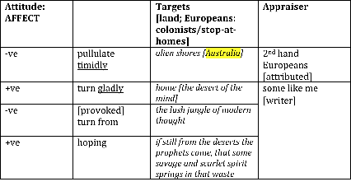
affect
Affector
Affected
The spirit of Australia?

Slide 50
affect
Affector
Affected
Only two instances of affect is inscribed – one close to the only instance of Mental Process

Slide 51
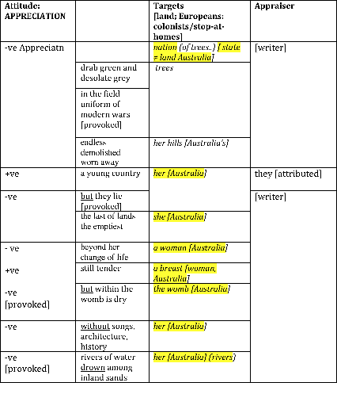
appreciation
targets:
Australia [metonomy: she, her, a woman]
Australia [meronomy: rivers, sands, cities]

Slide 52
appreciation
All positives
are retracted

Slide 53
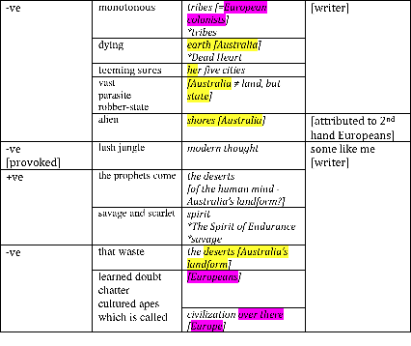
more appreciation..
and semantic clusters
appraised
appraiser
water, rivers, dry, drown, floods, drains
desert, sands, waste, empty, dying, savage
The only positive
is the desert/that waste
Sphinx, stone lion, worn away, emptiest, desert, Arabian desert, prophets, tribes,
that waste

Slide 54
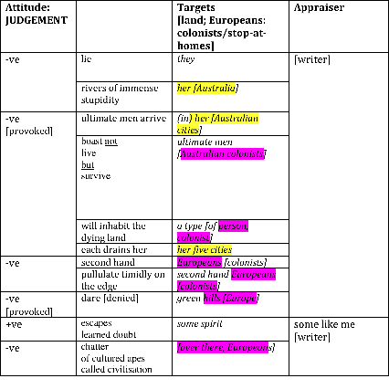
judgement
..and more meaning clusters
parasite, teeming sores, robber-state, drains, pullulate timidly
stupidity, monotonous, superstitions, boast, learned doubt, chatter, cultured apes

Slide 55
judgement
..and more meaning clusters
The only positive judgement accorded to ‘some spirit which escapes..’

Slide 56
Appraisal here operates via metaphor, contrast, and associations e.g.
“All beings so far have created something beyond themselves; and do you want to be the ebb of this great flood and even go back to the beasts rather than overcome man? What is the ape to man? A laughingstock or a painful embarrassment. And man shall be just that for the Übermensch: a laughingstock or a painful embarrassment…”
(Neitsche, from Thus Spake Zarathustra, 1883)
“the ultimate men”

Slide 57
Appraisal here operates via metaphor, contrast, and associations e.g.
Pullulate timidly on the edge of alien shores versus turn gladly home
The lush jungle of modern thought versus the Arabian desert of the human mind
Savage and scarlet versus green hills
ultimate men (ubermensch; irony), survive, not live
second hand Europeans, monotonous tribes, a type inhabiting dying earth, chattering apes
some spirit which escapes....

Slide 58
How are Australia and its inhabitants represented…
using Processes and Participants?
Material
Mental
Verbal
Relational
Existential
Subject- Participants

Slide 59
4. Floods her monotonous tribes from Cairns to Perth.
In them at last the ultimate men arrive
Whose boast is not: "we live" but "we survive",
A type who will inhabit the dying earth.
5. And her five cities, like five teeming sores,
Each drains her: a vast parasite robber-state
Where second hand Europeans pullulate
Timidly on the edge of alien shores.
6. Yet there are some like me[who] turn gladly home
From the lush jungle of modern thought, to find
The Arabian desert of the human mind,
Hoping, if still from the deserts the prophets come,
7. Such savage and scarlet as no green hills dare
Springs in that waste, some spirit which escapes
The learned doubt, the chatter of cultured apes
Which is called civilization over there.
1. Nation of trees, drab green and desolate grey
In the field uniform of modern wars,
Darkens her hills, those endless, outstretched paws
Of Sphinx demolished or stone lion worn away.
2. They call her a young country, but they lie:
She is the last of lands, the emptiest,
A woman beyond her change of life, a breast
Still tender but within the womb is dry.
3. Without songs, architecture, history:
The emotions and superstitions of younger lands,
Her rivers of water drown among inland sands,
The river of her immense stupidity
The only Mental and Existential Processes occur after the ‘Yet..’, in the “Lyric Coda” stage
The same stanza as the only +ve Affect

Slide 60
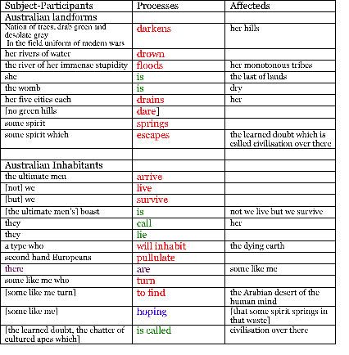
Many Material Processes do not have Goals, but Ranges.. or they are Behavioural
…compared with the McKellar piece?

Slide 61
AD Hope addresses an audience of Australians about their nation’s identity.
He repudiates the vision of a ‘young country’ by referring to its landforms..
Separates himself and others who also repudiate European ‘culture’, preferring the sparse dryness that Australia offers.
The metaphor relates the landforms of Australia (desert, waste, nation of trees, rivers of stupidity) with the nation =
its (European) inhabitants

Slide 62
The next piece is taken from the lyrics of a song, first published in 1987.
It also links the land of Australia with its inhabitants, but instead of metaphor using landforms, the ‘country’ as a whole is represented through the voice of the Appraiser/ Speaker.
It also addresses an audience of European immigrants inhabitants, and repudiates their Attitudes towards Australia.
“The Dead Heart”. Hirst and Moginie. 1987

Slide 63

‘the dead heart lives here’
link to youtube
(1987)
‘the dead heart’: a nickname for
The centre of Australia
the centre is desert, i.e. dead
..but the heart is essential for life →
so a ‘dead’ heart renders the body dead also..
Published same year as McKellar poem written
1906

Slide 64
what is repudiated
1
We don't serve your country
Don't serve your king
^ Know your custom
Don't speak your tongue
White man came took everyone
2
We don't serve your country
Don't serve your king
White man [^]listen to the songs we sing
White man came took everything
3
We carry in our hearts the true country
And that cannot be stolen
We follow in the steps of our ancestry
And that cannot be broken
4
We don't need protection
Don't need your land
[you don't] Keep your promise on where we stand
We will listen, we will understand
5
Mining companies, pastoral companies
Uranium companies
Collected companies
Got more right than people
Got more say than people
6
Forty thousand years can make a difference to the state of things
The dead heart lives here.
7
We carry in our hearts the true country
And that cannot be stolen
We follow in the steps of our ancestry
And that cannot be broken

Slide 65
what is valorised
1
We don't serve your country
Don't serve your king
^ Know your custom
Don't speak your tongue
White man came took everyone
2
We don't serve your country
Don't serve your king
White man [^]listen to the songs we sing
White man came took everything
3
We carry in our hearts the true country
And that cannot be stolen
We follow in the steps of our ancestry
And that cannot be broken
4
We don't need protection
Don't need your land
[you don't] Keep your promise on where we stand
We will listen, we will understand
5
Mining companies, pastoral companies
Uranium companies
Collected companies
Got more right than people
Got more say than people
6
Forty thousand years can make a difference to the state of things
The dead heart lives here.
7
We carry in our hearts the true country
And that cannot be stolen
We follow in the steps of our ancestry
And that cannot be broken

Slide 66
Hirst and Moginie appropriate an aboriginal voice to make a claim for legitimacy:
“We carry in our hearts the true country” (not landform)
[compare: “Core of my heart, my country!” by McKellar]
We follow in the steps of our ancestry, that cannot be broken
40,000 years can make a difference
[compare European settlement for 250 years]
people
[compare no mention of aboriginal inhabitants in previous two pieces]

Slide 67
Processes
1
We don't serve your country
Don't serve your king
^ Know your custom
Don't speak your tongue
White man came took everyone
2
We don't serve your country
Don't serve your king
White man [^]listen to the songs we sing
White man came took everything
3
We carry in our hearts the true country
And that cannot be stolen
We follow in the steps of our ancestry
And that cannot be broken
4
We don't need protection
Don't need your land
[you don't] Keep your promise on where we stand
We will listen, we will understand
5
Mining companies, pastoral companies
Uranium companies
Collected companies
Got more right than people
Got more say than people
6
Forty thousand years can make a difference to the state of things
The dead heart lives here.
7
We carry in our hearts the true country
And that cannot be stolen
We follow in the steps of our ancestry
And that cannot be broken

Slide 68
Instances of Material Processes with Actor

Slide 69
Comparison of Process Types used as Percentage of all Processes

Slide 70
Comparing types and instances of Attitude in the three texts...

Slide 74
less linguistic abstraction, more experiential, more reliance on metaphor:
more invoked

Slide 75
Attitudes in ‘The Dead Heart’ (Moginie) are generally invoked in complicated ways depending on associations and shared values…
A short look at how these were interpreted, dependent on time available

Slide 76
In conclusion..
Appraisal and Attitude analysis can be used ~
to tease apart the ways that values accumulate around specific entities and artefacts over periods of time
to highlight patterns and/or groupings of values in particular textual artefacts
to understand how literary works invite response through these groupings of values and associations
to compare related texts in order to reveal relative values and stances

Slide 77
In conclusion..
Transitivity analysis can be used ~
to investigate what entities are given Active roles – who or what is represented as having power over what
to show who or what is accorded Active roles in comparison to roles such as Senser or Carrier roles
to understand how literary works invite response through patterns of roles and arrangement of marked roles in the staging or development of a piece
to compare related texts in order to reveal relative active and passive roles

Slide 78
In conclusion..
Using Appraisal and transitivity analysis together can reveal further patterns ~
In this case, the analyses are used to reveal patterns of values surrounding entities that are associated with the idea of an Australian identity -
Iconic landforms, the country itself, its inhabitants…
To highlight the way in which the style of the text is managed for rhetorical effect

Slide 79
